Slide 1
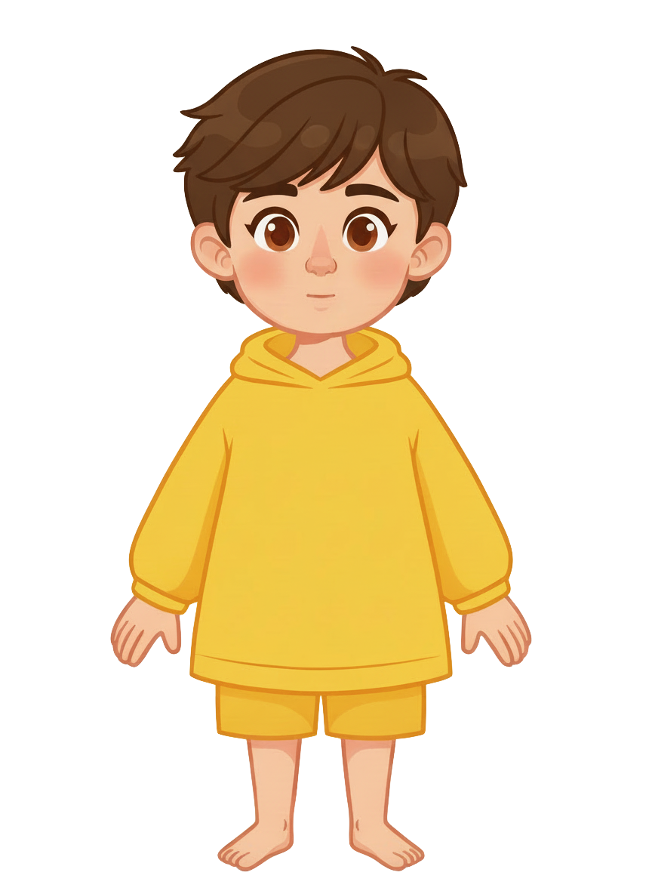
This is Sam

Slide 2


Sam has three
cookies

Slide 3
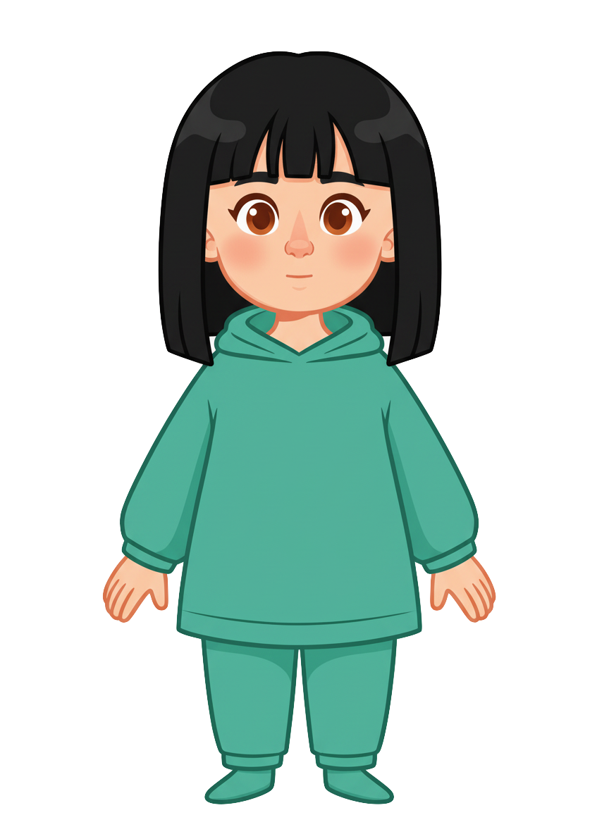
This is Ella

Slide 4
Ella has
three cookies

Slide 5
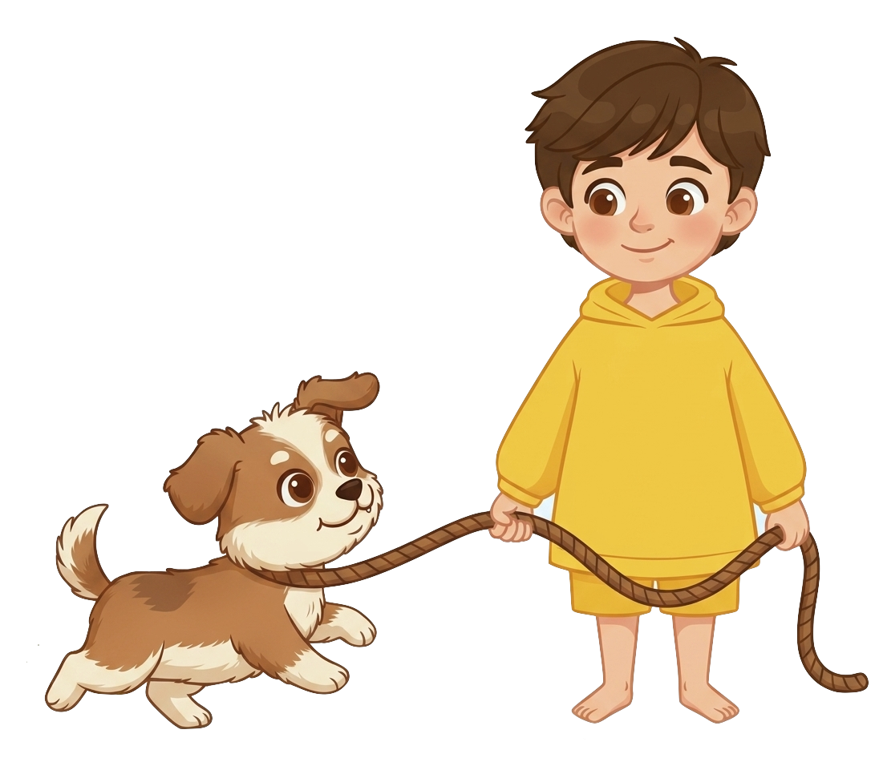

Sam is walking his dog

Slide 6
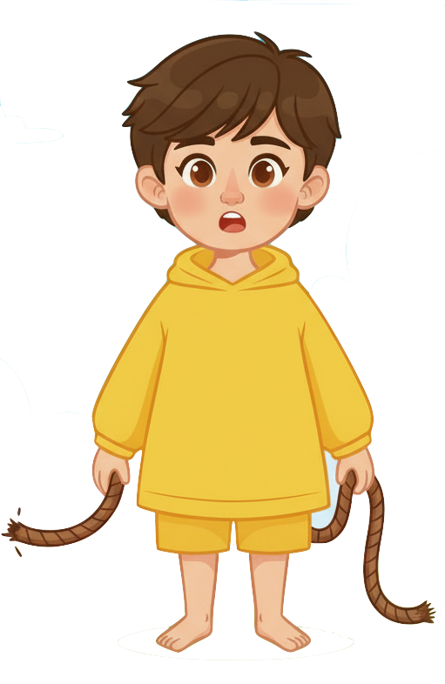
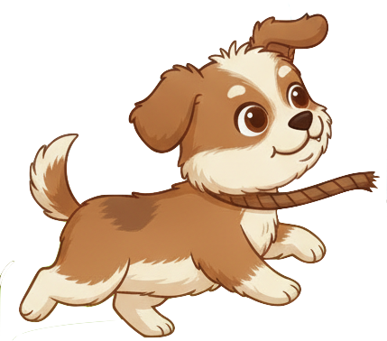
The dog broke free from the leash

Slide 7
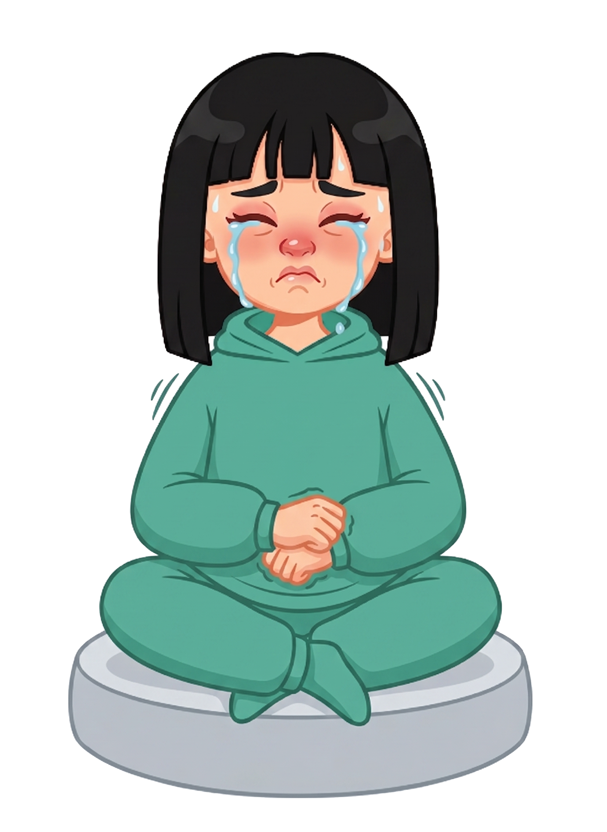

The dog ate one of the cookie!

Slide 8

The dog ate one of the cookie!

Slide 9
Sam still has 3 cookies. Ella now has 2 cookies.

Slide 10
Please decide whether you would like to move some of Sam’s cookies.

